Slide 1
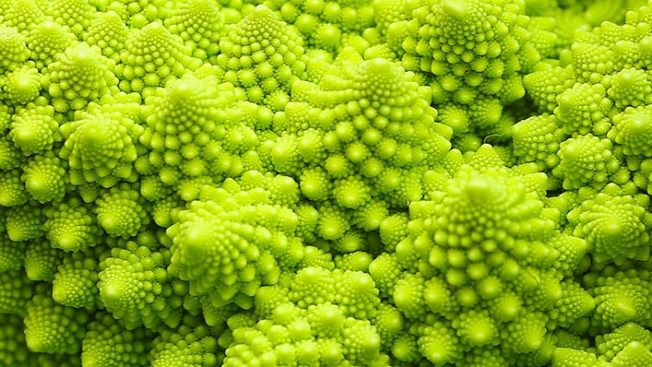
RECURSION

Slide 2
Objectives:
To learn and understand the following concepts:
To design a recursive algorithm
To solve problems using recursion
To understand the relationship and difference between recursion and iteration

Slide 3
Session outcome:
At the end of session one will be able to :
Understand recursion
Write simple programs using recursive functions

Slide 4
What is Recursion ?
Sometimes, the best way to solve a problem is by solving a smaller version of the exact same problem first.
Recursion is a technique that solves a problem by solving a smaller problem of the same type.
A recursive function is a function that invokes / calls itself directly or indirectly.
In general, code written recursively is shorter and a bit more elegant, once you know how to read it.
It enables you to develop a natural, straightforward, simple solution to a problem that would otherwise be difficult to solve.
Notes:
A recursive function is a function that invokes itself directly or indirectly.
Recursion is a useful programming technique.
In some cases, using recursion enables you to develop a natural, straightforward, simple solution to a problem that would otherwise be difficult to solve.
What is recursion? Recursion is a programming method in which a function calls itself. Recursion is a powerful concept for programmers. Some programming languages, such as LISP and Prolog, are specificallydesigned to use recursive methods.
recursion n. 1 the act of returning. 2 (Math) the repeated application of a mathematical procedure to a
preceding result to generate a sequence of values.

Slide 5
What is Recursion ?
Mathematical problems that are recursive in nature like factorial, fibonacci, exponentiation, GCD, Tower of Hanoi, etc. can be easily implemented using recursion.
Every time when we make a call to a function, a stack frame is allocated for that function call where all the local variables in the functions are stored. As recursion makes a function to call itself many times till the base condition is met, many stack frames are allocated and it consumes too much main memory and also makes the program run slower.
We must use recursion only when it is easy and necessary to use, because it takes more space and time compared to iterative approach.
Notes:
A recursive function is a function that invokes itself directly or indirectly.
Recursion is a useful programming technique.
In some cases, using recursion enables you to develop a natural, straightforward, simple solution to a problem that would otherwise be difficult to solve.
What is recursion? Recursion is a programming method in which a function calls itself. Recursion is a powerful concept for programmers. Some programming languages, such as LISP and Prolog, are specificallydesigned to use recursive methods.
recursion n. 1 the act of returning. 2 (Math) the repeated application of a mathematical procedure to a
preceding result to generate a sequence of values.

Slide 6
Recursive Thinking …..
Recursive Process
A child couldn't sleep, so her mother told a story about a little frog,
who couldn't sleep, so the frog's mother told a story about a little bear,
who couldn't sleep, so bear's mother told a story about a little weasel
...who fell asleep.
...and the little bear fell asleep;
...and the little frog fell asleep;
...and the child fell asleep.

Slide 7
Steps to Design a Recursive Algorithm
Base case:
It prevents the recursive algorithm from running forever.
Recursive steps:
Identify the base case for the algorithm.
Call the same function recursively with the parameter having slightly modified value during each call.
This makes the algorithm move towards the base case and finally stop the recursion.

Slide 8
Let us consider the code …
int main() {
int i, n, sum=0;
printf("Enter the limit“);
scanf(“%d”,n);
printf("The sum is %d“,fnSum(n));
return 0;
}
int fnSum(int n){
int sum=0;
for(i=1;i<=n;i++)
sum=sum+i;
return (sum);
}

Slide 9
Let us consider same code again …
int main() {
int i, n, sum=0;
printf("Enter the limit“);
scanf(“%d”, n);
printf(“The sum is %d“,fnSum(n));
return 0;
}
int fnSum(int n){
int sum=0;
for(i=1;i<=n;i++)
sum=sum+i;
return (sum);
}
int fnSum(int x) {
if (x == 1) //base case
return 1;
else
return fnSum(x-1) + x; //recursive case
}

Slide 10

Factorial of a natural number– a classical recursive example
So factorial(5)
= 5* factorial(4)
= 4* factorial(3)
= 3*factorial(2)
= 2* factorial(1)
= 1*factorial(0)
= 1
Notes:
Many mathematical functions are defined using recursion. The factorial of a number n can be recursively defined as
follows:
0! = 1;
n! = n × (n - 1)!; n > 0
How do you find n! for a given n? It is easy to find 1! because you know 0! and 1! is 1 × 0!. Assuming that you know (n-1)!, n! can be obtained immediately using n × (n-1)!. Thus, the problem of computing n! is reduced to computing (n-1)!. When computing (n-1)!, you can apply the same idea recursively until n is reduced to 0.
Let factorial(n) be the function for computing n!. If you call the function with n = 0, it immediately returns the result. The function knows how to solve the simplest case, which is referred to as the base case or the stopping condition. If you call the function with n > 0, it reduces the problem into a subproblem for computing the factorial of n - 1. The subproblem is essentially the same as the original problem, but is simpler or smaller than the original. Because the subproblem has the same property as the original, you can call the function with a different argument, which is referred to as a recursive call.

Slide 11
Factorial- recursive procedure
#include <stdio.h>
long factorial (long a) {
if (a ==0) //base case
return (1);
return (a * factorial (a-1));
}
int main () {
long number;
printf("Please enter the number: “);
scanf(“%d”, &number);
printf(“%ld! = %ld”, number, factorial (number));
return 0;
}
Output:
n = 5
5! = 120
Notes:
The recursive algorithm for computing factorial(n) can be
simply described as follows:
if (n == 0)
return 1;
else
return n * factorial(n - 1);
A recursive call can result in many more recursive calls because the function is dividing a subproblem into new subproblems. For a recursive function to terminate, the problem must eventually be reduced to a stopping case. When it reaches a stopping case, the function returns a result to its caller. The caller then performs a computation and returns the result to its own caller. This process continues until the result is passed back to the original caller. The original problem can now be solved by multiplying n with the result of factorial(n-1).
The factorial function (lines 19–24) is essentially a direct translation of the recursive mathematical definition for the factorial into C++ code. The call to factorial is recursive because it calls itself. The parameter passed to factorial is decremented until it reaches the base case of 0.

Slide 12
Recursion - How is it doing!
rFact(5)
120
x
=24
=
5
rFact(4)
120
Notice that the recursion isn’t finished at the bottom --
It must unwind all the way back to the top in order to be done.
x
=6
4
rFact(3)
=
24
x
rFact(2)
=
6
3
=2
factorial(0) = 1
factorial(n) = n * factorial(n-1) [for n>0]
long rFact (long a) {
if (a ==0)
return (1);
return (a * rFact (a-1));
}
x
rFact(1)
=
2
2
=1
x
rFact(0)
=1
=
1
1
Notes:
Figure illustrates the execution of the recursive calls, starting with n=5.
Infinite recursion can occur if recursion does not reduce the problem in a manner that allows it to eventually converge into the base case. For example, if you mistakenly write the factorial function as follows:
int factorial(int n)
{
return n * factorial(n - 1);
}
The function runs infinitely and causes the stack overflow.
NOTE:
It is simpler and more efficient to implement the factorial function using a loop. However, the recursive factorial function is a good example to demonstrate the concept of recursion.

Slide 13
Fibonacci Numbers: Recursion
fibonacci(0) = 0
fibonacci(1) = 1
fibonacci(n) = fibonacci(n-1) + fibonacci(n-2) [for n>1]
So fibonacci(4)
= fibonacci(3) + fibonacci(2)
= (fibonacci(2) + fibonacci(1)) + (fibonacci(1) + fibonacci(0))
= ((fibonacci(1) + fibonacci(0)) + 1) + (1 + 0)
= ( 1 + 0 ) + 1) + (1 + 0)
= 3
Notes:
The factorial function in the preceding section could easily be rewritten without using recursion. In some cases, however, using recursion enables you to give a natural, straightforward, simple solution to a program that would otherwise be difficult to solve. Consider the well-known Fibonacci series problem, as follows:
The series: 0 1 1 2 3 5 8 13 21 34 55 89 . . .
indices(n): 0 1 2 3 4 5 6 7 8 9 10 11
The Fibonacci series begins with 0 and 1, and each subsequent number is the sum of the preceding two numbers in the series. The series can be recursively defined as follows:
fib(0) = 0;
fib(1) = 1;
fib(index) = fib(index - 2) + fib(index - 1); index >= 2
The Fibonacci series was named for Leonardo Fibonacci, a medieval mathematician, who originated it to model the growth of the rabbit population. It can be applied in numeric optimization and in various other areas.
How do you find fib(index) for a given index? It is easy to find fib(2) because you know fib(0) and fib(1). Assuming
that you know fib(index-2) and fib(index-1), fib(index) can be obtained immediately. Thus, the problem of computing fib(index) is reduced to computing fib(index-2) and fib(index-1). When computing fib(index-2) and fib(index-1), you apply the idea recursively until index is reduced to 0 or 1.
The base case is index=0 or index=1. If you call the function with index=0 or index=1, it immediately returns the result. If you call the function with index>=2, it divides the problem into two subproblems for computing fib(index-1) and fib(index-2) using recursive calls.

Slide 14

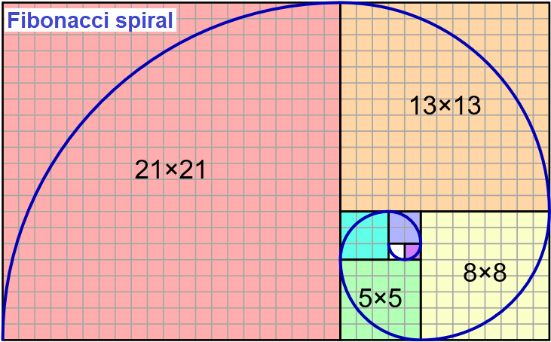
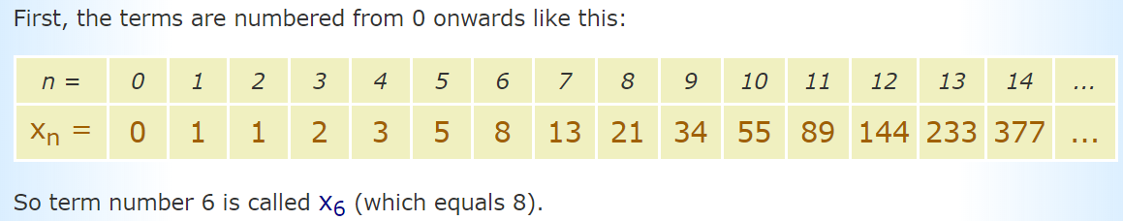
Fibonacci Numbers: Recursion
Fibonacci series is 0,1, 1, 2, 3, 5, 8 …
int rfibo(int n)
{
if (n <= 1)
return n;
else
return (rfibo(n-1) + rfibo(n-2));
}
Output:
n = 4
fib = 3
Notes:
The recursive algorithm for computing fib(index) is given. When this recursive function is called with n = 4, the function returns 3.
The Fibonacci Sequence is numbered from 0 onwards like this:
n = 0 1 2 3 4 5 6 7 8 9 10 11 12 13 14...
x_{n} =0 1 1 2 3 5 8 13 21 34 55 89 144 233 377...
A Fibonacci spiral is a series of connected quarter-circles drawn inside an array of squares with Fibonacci numbers for dimensions. The squares fit perfectly together because of the nature of the sequence, where the next number is equal to the sum of the two before it.

Slide 15
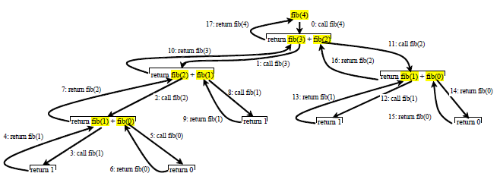
Recursive Calls initiated by Fib(4)
Notes:
The program does not show the considerable amount of work done behind the scenes by the computer. however,
shows successive recursive calls for evaluating fib(4). The original function, fib(4), makes two recursive calls, fib(3)
and fib(2), and then returns fib(3) + fib(2). But in what order are these functions called? Operands for the binary +
operator are evaluated from left to right. The labels in Figure show the order in which functions are called.
As shown in Figure, there are many duplicated recursive calls. For instance, fib(2) is called twice, fib(1) is called three times, and fib(0) is called twice. In general, computing fib(index) requires twice as many recursive calls as are needed for computing fib(index - 1). As you try larger index values, the number of calls substantially increases. Besides the large number of recursive calls, the computer requires more time and space to run recursive functsions.

Slide 16
Fibonacci Series using Recursion
int rfibo(int);
int main(void){
int n,i, a[20], fibo;
printf("enter any num to n\n“);
scanf(“%d”, n);
printf(“Fibonacci series “);
for (i=1; i<=n; i++) {
fibo = rfibo(i);
printf(“%d”, fibo);
}
return 0;
}
Notes:
Program to generate fibonacci series upto n using recursive fibonacci function rfibo(int).

Slide 17
Factorial- recursive procedure – A revisit
long factorial (long a) {
if (a ==0) //base case
return (1);
return (a * factorial (a-1));
}
int main () {
long number;
printf("Please enter the number: “);
scanf(“%d”, &number);
printf(“%ld! = %ld”, number, factorial (number));
return 0;
}
Output:
n = 5
5! = 120
Notes:
The recursive algorithm for computing factorial(n) can be
simply described as follows:
if (n == 0)
return 1;
else
return n * factorial(n - 1);
A recursive call can result in many more recursive calls because the function is dividing a subproblem into new subproblems. For a recursive function to terminate, the problem must eventually be reduced to a stopping case. When it reaches a stopping case, the function returns a result to its caller. The caller then performs a computation and returns the result to its own caller. This process continues until the result is passed back to the original caller. The original problem can now be solved by multiplying n with the result of factorial(n-1).
The factorial function (lines 19–24) is essentially a direct translation of the recursive mathematical definition for the factorial into C++ code. The call to factorial is recursive because it calls itself. The parameter passed to factorial is decremented until it reaches the base case of 0.

Slide 18
Recursion - How is it doing!
rFact(5)
120
x
=24
=
5
rFact(4)
120
Notice that the recursion isn’t finished at the bottom --
It must unwind all the way back to the top in order to be done.
x
=6
4
rFact(3)
=
24
x
rFact(2)
=
6
3
=2
factorial(0) = 1
factorial(n) = n * factorial(n-1) [for n>0]
long rFact (long a) {
if (a ==0)
return (1);
return (a * rFact (a-1));
}
x
rFact(1)
=
2
2
=1
x
rFact(0)
=1
=
1
1
Notes:
Figure illustrates the execution of the recursive calls, starting with n=5.
Infinite recursion can occur if recursion does not reduce the problem in a manner that allows it to eventually converge into the base case. For example, if you mistakenly write the factorial function as follows:
int factorial(int n)
{
return n * factorial(n - 1);
}
The function runs infinitely and causes the stack overflow.
NOTE:
It is simpler and more efficient to implement the factorial function using a loop. However, the recursive factorial function is a good example to demonstrate the concept of recursion.

Slide 19
Static Variable:
The value of static variable persists until the end of the program.
Static variables can be declared as
static int x;
A static variable can be either an internal or external type depending on the place of declaration.
void fnStat( );
int main() {
int i;
for( i= 1; i<=3; i++)
fnStat( );
return 0;
}
void fnStat( ){
int x = 0;
x = x + 1;
printf(“x=%d”, x);
}
static int x = 0;
Output:
x = 1
x = 2
x = 3
Output:
x = 1
x = 1
x = 1
Notes:
A storage class is an attribute that changes the behavior of a variable. It controls the lifetime, scope and linkage.
Auto(Automatic variable) default type, automatic variables are the ones we’ve have been using.
Extern (External variable) tells the computer that the variable is defined elsewhere in the program.
Register tells the computer to use one of the CPU’s registers.
Static persists (it’s value remains) even after leaving function.

Slide 20
Reversing a Number
int rev(int num){
static int n = 0;
if(num > 0)
n = (n* 10) + (num%10) ;
else
return n;
return rev(num/10);
}
#include <stdio.h>
int rev(int);
int main() {
int num;
printf(“enter number)”;
scanf(“%d”,num);
printf(“%d”, rev(num));
return 0;
}
Output:
num = 234
rev = 432
Notes:
A recursive function to reverse a given number is given. It makes use static variable n initialized to 0. If the num>0, n is set to n*10 + num%10; then again the same function is called with num = num/10. Between the recursive calls, the value of n persists. When num = 0, the function returns the value of n to main function.
For eg, the function call rev(234) results in:
num n recursive call
234 0*10+234%10= 4 rev(23)
23 4*10+23%10=43 rev(2)
2 43*10+2%10=432 rev(0)
0 return(432)
This value is returned to the intermediate calls and finally returned to main.

Slide 21
Sorting a list – Recursive
Base Case:
if length of the list (n) = 1
No sorting, return
Recursive Call:
1. Find the smallest element in the list and place it in the 0th position
2. Sort the unsorted array from 1.. n-1
sortR(&list[1], n-1)
For eg: list [ ] = {33,-2,0,2,4} n=5
Notes:
In this recursive sort function, if the length of the list = 1, we return(only one element, no sorting). Otherwise, we find the minimum element and place in 0th position. Next, we call the same function as sort(&list[1], length-1). Now, we sort the list list[1], list[2]...list[n-1] by finding and placing the smallest element in list[1]. Again, the process is repeated with the new list until length of list =1.

Slide 22
Sorting a list
list[ ] function calls
{33,-2,0,2,4} sort(list,5) Main()
{-2,33,0,2,4} sort(&list[1],4)
{-2,0,33,2,4} sort(&list[1],3)
{-2,0,2,33,4} sort(&list[1],2)
{-2,0,2,4,33} sort(&list[1],1)
Base case reached .... Return
Notes:
For eg: list [] = {33,-2,0,2,4} n=5
sort(list,ln) will result in:
List (beginning of fn) List (end of fn) n function call
33 -2 0 2 4 -2 33 0 2 4 5 sort(&list[1], 4)
33 0 2 4 0 33 2 4 4 sort(&list[1],3)
33 2 4 2 33 4 3 sort(&list[1],2)
33 4 4 33 2 sort(&list[1],1)
33 33 1 no recursive call as base case is reached, return.
From here, after a series of returns, control is transferred to main and the array is now sorted.

Slide 23
Sorting a list
sortR(list, n);// call of fn & display of sorted array in main()
int sortR(int list[], int ln){
int i, tmp, min;
if (ln == 1)
return 0;
/* find index of smallest no */
min = 0;
for(i = 1; i < ln; i++)
if (list[i] < list[min])
min = i;
/* move smallest element to 0-th element */
tmp = list[0];
list[0] = list[min];
list[min] = tmp;
/* recursive call */
return sortR(&list[1], ln-1);
}
Output:
Orign. array-: 33 -2 0 2 4
Sorted array -: -2 0 2 4 33

Slide 24
Recursion - Should I or Shouldn’t I?
Pros
Recursion is a natural fit for recursive problems
Cons
Recursive programs typically use a large amount of computer memory and the greater the recursion, the more memory used
Recursive programs can be confusing to develop and extremely complicated to debug
Notes:
Performance concern
If you are concerned about your program’s performance, avoid using recursion, because it takes more time and consumes more memory than iteration.
The decision whether to use recursion or iteration should be based on the nature of the problem you are trying to solve and your understanding of the problem. The rule of thumb is to use whichever of the two approaches can best develop an intuitive solution that naturally mirrors the problem. If an iterative solution is obvious, use it. It will generally be more efficient than the recursive option.

Slide 25
Recursion vs Iteration
RECURSION | ITERATION
Uses more storage space requirement | Less storage space requirement
Overhead during runtime | Less Overhead during runtime
Runs slower | Runs faster
A better choice, a more elegant solution for recursive problems | Less elegant solution for recursive problems
Notes:
Recursion is an alternative form of program control. It is essentially repetition without a loop control. When you use
loops, you specify a loop body. The repetition of the loop body is controlled by the loop-control structure. In recursion, the function itself is called repeatedly. A selection statement must be used to control whether to call the function recursively or not.
Recursion bears substantial overhead. Each time the program calls a function, the system must assign space for all of the function’s local variables and parameters. This can consume considerable memory and requires extra time to
manage the additional space.
Any problem that can be solved recursively can be solved nonrecursively with iterations. Recursion has many negative aspects: it uses up too much time and too much memory. Why, then, should you use it? In some cases, using recursion enables you to specify a clear, simple solution that would otherwise be difficult to obtain. The decision whether to use recursion or iteration should be based on the nature of the problem you are trying to solve
and your understanding of the problem. The rule of thumb is to use whichever of the two approaches can best develop an intuitive solution that naturally mirrors the problem. If an iterative solution is obvious, use it. It will generally be more efficient than the recursive option.
Recursion Vs Iteration
A recursive version of a method typically executes less efficiently than the corresponding iterative version. This is because the computer must keep track of the recursive calls and the suspended computations. However, it can be much easier to write a recursive method than it is to write a corresponding iterative method.
A recursive version of a method typically executes less efficiently than the corresponding iterative version. This is because the computer must keep track of the recursive calls and the suspended computations. However, it can be much easier to write a recursive method(for recursive problems) than it is to write a corresponding iterative method.
Similarities between recursion and iteration
Iteration
Loop repetition condition determines whether to repeat the loop body or exit from the loop
Recursion
The condition usually tests for a base case
You can always write an iterative solution to a recursion
But can you always write a recursion for an iteration problem?
Which one is best?
Difference between iteration and recursion is:
With iteration, each step clearly leads onto the next, like stepping stones across a river.
In recursion, each step replicates itself at a smaller scale, so that all of them combined together eventually solve the problem.
Recursion vs. Iteration
Both iteration and recursion are based on a control structure
▪ Iteration uses a repetition structure; recursion uses a selection structure
▪ Both recursion and iteration involve repetition: iteration explicitly uses a repetition structure; recursion
achieve repetition trough repeated function calls
▪ Iteration and recursion each involve a termination test: iteration terminates when the loop condition fails;
recursion terminates when a base case is recognized.
Why choose recursion?
Any problem, that can be solved recursively can also be solved iteratively (nonrecursively). Recursive calls
take time and consume additional memory.
So why choose recursion ?
▪ When the recursive approach more naturally mirrors the problem and results in program that is easier to
understand and debug.
▪ An iterative solution may not be apparent.

Slide 26
Recursion – Do’s
You must include a termination condition or Base Condition in recursive function; Otherwise your recursive function will run “forever” or infinite.
Each successive call to the recursive function must be nearer to the base condition.

Slide 27

GCD: Recursion
The greatest common divisor (gcd) of two positive integers is the largest integer that divides evenly into both of them. For example, the greatest common divisor of 24 and 9 is 3 since both 24 and 9 are multiples of 3, but no integer larger than 3 divides evenly into 24 and 9.
We can efficiently compute the gcd using the following property, which holds for positive integers x and y:
If x > y,
the gcd of x and y is the same as
the gcd of y and x % y
Using this we can write the recursive definition of GCD as:
Notes:
The Euclidean algorithm is based on the principle that the greatest common divisor of two numbers does not change if the larger number is replaced by its difference with the smaller number. For example, 21 is the GCD of 252 and 105 (252 = 21 × 12 and 105 = 21 × 5), and the same number 21 is also the GCD of 105 and 147 = 252 − 105. Since this replacement reduces the larger of the two numbers, repeating this process gives successively smaller pairs of numbers until one of the two numbers reaches zero. When that occurs, the other number (the one that is not zero) is the GCD of the original two numbers.
The greatest common divisor (gcd) of two positive integers is the largest integer that divides evenly into both of them. For example, the greatest common divisor of 24 and 9 is 3 since both 24 and 9 are multiples of 3, but no integer larger than 3 divides evenly into 24 and 9.
We can efficiently compute the gcd using the following property, which holds for positive integers p and q:
If p > q,
the gcd of p and q is the same as
the gcd of q and p % q
Using this we can write the recursive definition of GCD as:
gcd(x,y) = x if y =0
y if x=0
gcd(y,x%y) otherwise

Slide 28
GCD: Recursion
int gcd(int x, int y)
{
if (y==0)
return (x);
return gcd(y, x % y);
}
Output:
x= 24 , y = 9
gcd = 3
gcd(24,9) ← Control In gcd fn on call gcd(9,24%9) gcd(9, 6) gcd(6,9%6) gcd(6, 3) gcd(3,6%3) gcd(3, 0) return values return 3 return 3 return 3 return 3
Notes:
The Euclidean algorithm is based on the principle that the greatest common divisor of two numbers does not change if the larger number is replaced by its difference with the smaller number. For example, 21 is the GCD of 252 and 105 (252 = 21 × 12 and 105 = 21 × 5), and the same number 21 is also the GCD of 105 and 147 = 252 − 105. Since this replacement reduces the larger of the two numbers, repeating this process gives successively smaller pairs of numbers until one of the two numbers reaches zero. When that occurs, the other number (the one that is not zero) is the GCD of the original two numbers.
The greatest common divisor (gcd) of two positive integers is the largest integer that divides evenly into both of them. For example, the greatest common divisor of 24 and 9 is 3 since both 24 and 9 are multiples of 3, but no integer larger than 3 divides evenly into 24 and 9.
We can efficiently compute the gcd using the following property, which holds for positive integers p and q:
If p > q,
the gcd of p and q is the same as
the gcd of q and p % q
Using this we can write the recursive definition of GCD as:
gcd(x,y) = x if y =0
y if x=0
gcd(y,x%y) otherwise

Slide 29
Recursive Problem- Finding product of two numbers
#include <stdio.h>
int product(int, int);
int main()
{
int a, b, result;
printf("Enter two numbers to find their product: ");
scanf("%d%d", &a, &b);
result = product(a, b);
printf("%d * %d = %d\n", a, b, result);
return 0;
}
int product(int a, int b)
{
if (a < b)
{
return product(b, a);
}
else if (b != 0)
{
return (a + product(a, b - 1));
}
else
{
return 0;
}
}
Output:
Enter two numbers to find their product: 10 20
10*20=200

Slide 30
Recursive Problem- Dividing two numbers
#include <stdio.h>
int divide(int a, int b);
int main()
{
int a,b;
printf("Enter two numbers for division");
scanf("%d%d", &a,&b);
printf("%d/%d=%d",a,b,divide(a,b));
return 0;
}
int divide(int a, int b){
if(a - b <= 0)
{
return 1;
}
else
{
return divide(a - b, b) + 1;
}
}
Output:
Enter two numbers for division: 20 10
20/10=2

Slide 31
Recursive Problem- Calculating power of a number
int power(int n1, int n2);
int main() {
int base, powerRaised, result;
printf("Enter base number: ");
scanf("%d",&base);
printf("Enter power number);
scanf("%d",&powerRaised);
result = power(base, powerRaised);
printf("%d^%d = %d", base, powerRaised, result);
return 0;
}
int power(int base, int powerRaised) {
if (powerRaised != 0)
return (base*power(base, powerRaised-1));
else
return 1;
}
Output:
Enter base number:3
Enter power number: 4
3^4=81

Slide 32
Recursive Problem- Sum of natural numbers
#include <stdio.h>
int sum(int n);
int main() {
int number, result;
printf("Enter a positive integer: ");
scanf("%d", &number);
result = sum(number);
printf("sum=%d", result);
}
int sum(int num)
{
if (num!=0)
return num + sum(num-1);
else
return num;
}
Output:
Enter a positive integer: 10
Sum= 55

Slide 33
Recursive Problem- To count number of digits
int countDigits(int);
int main() {
int number;
int count=0;
printf("Enter a positive integer number: ");
scanf("%d",&number);
count=countDigits(number);
printf(“Number of digits is: %d\n",count);
return 0;
}
int countDigits(int num) {
static int count=0;
if(num>0) {
count++;
countDigits(num/10);
}
else {
return count;
}
}
Output:
Enter a positive integer number: 123
Number of digits is: 3

Slide 34
Recursive Problem- To find sum of all digits
int sumDigits(int num);
int main()
{
int number,sum;
printf("Enter a positive integer number: ");
scanf("%d",&number);
sum=sumDigits(number);
printf("Sum of all digits are: %d\n",sum);
return 0;
}
int sumDigits(int num){
static int sum=0;
if(num>0) {
sum+=(num%10);
sumDigits(num/10);
}
else
{
return sum;
}
}
Output:
Enter a positive integer number: 123
Number of digits is: 3

Slide 35
Recursive Problem- To find length of a string
int length(char str[], int index)
{
if (str[index] == '\0')
{
return 0;
}
return (1 + length(str, index + 1));
}
#include <stdio.h>
int length(char [ ], int);
int main() {
char str[20];
int count;
printf("Enter any string :: ");
scanf("%s", str);
count = length(str, 0);
printf("The length of string=%d.\n",count);
return 0;
}
Output:
Enter any string :: Manipal
The length of string= 7

Slide 36
Recursive Problem-Binary Search
int binarySearch(int x[ ],int element,int start,int end);
int main(){
int x[20],n,i,index,start=0,end,element;
printf("Enter number of elements: ");
scanf("%d",&n);
end = n;
printf("Enter array elements: ");
for(i=0;i<n;i++){
scanf("%d",&x[i]);
}
printf("Enter the element to search: ");
scanf("%d",&element);
index = binarySearch(x,element,start,end-1);
if(index == -1)
printf("Element Not Found.\n");
else
printf("Element found at index : %d\n",index);
return 0;
}

Slide 37
Binary Search
int binarySearch(int x[],int element,int start,int end){
int mid,noOfElements,i;
mid = (int)(start+end)/2;
if(start > end)
return -1;
if(x[mid] == element)
return mid;
else if(x[mid] < element){
start = mid+1;
binarySearch(x,element,start,end);
}
else{
start = 0;
end = mid-1;
binarySearch(x,element,start,end);
}
}
Output:
Enter number of elements: 5
Enter array elements: 1 2 3 4 5
Enter the element to search: 3
Element found at index : 2

Slide 38
Summary
Definition
Recursive functions
Problems Solving Using Recursion
Pros and Cons
Recursive Vs Iterative Function
Notes:
A recursive function is a function that invokes itself directly or indirectly.
For a recursive function to terminate, there must be one or more base cases.
• Recursion is an alternative form of program control. It is essentially repetition without a loop control.
It can be used to specify simple, clear solutions for inherently recursive problems that would otherwise be
difficult to solve.
• Sometimes the original function needs to be modified to receive additional parameters in order to be invoked
recursively. A recursive helper function can be declared for this purpose.
• Recursion bears substantial overhead. Each time the program calls a function, the system must assign space
for all of the function’s local variables and parameters. This can consume considerable memory and requires extra time to manage the additional space.

